Slide 1
Cherokee Verbs
Cherokee Language is more than 75% verbs and most of the nouns in Cherokee are created using verb bases (stems).
All Cherokee Verbs must have 3 key components:
  A Pronominal Prefix
  A Verb Stem (Verb Base) (Verb Root)
  A Final Suffix indicating tense
Cherokee Verbs can also have other Pre-stem prefixes such as Prepronominal and Postpronominal affixes.
Cherokee Verbs can also have other suffixes that do not indicate tense.

Slide 2
Cherokee Verbs - Structure
All verbs in Cherokee can have the following pieces
But all verbs MUST have a Pronoun Prefix, a Verb Stem, and a Final Suffix (tense marker)
Verb Structure (CED 241)
± initial prefix(es) | + pronoun prefix(es) | ± reflexive prefix | + verb stem | ± non-final suffix(es) | + final suffix

Slide 3
Cherokee Verbs – Key Components
  Transitive Verbs (subject to object)
    A Transitive Verb is a verb that transfers the property of the action to an Object.
    The Object in a Transitive Verb can be an animate (living), or inanimate (nonliving) entity.
      For Example: gvsgatlvsga = “I am hiding it.”
  Intransitive Verbs
    Intransitive Verbs do not transfer the property of the action to an Object.
    The Actor in an Intransitive Verb is simply performing the action.
      For Example: gadisgatlvsga = “I am hiding”

Slide 4
Cherokee Verbs – Key Components
  The Pronominal Prefix
    The Pronominal Prefix establishes who is involved in the action and may also indicate the object of the action
    For Intransitive Verbs, the Pronominal Prefix can be a Set A Prefix, which is typically used for Active Verbs
    For Intransitive Verbs, the Pronominal Prefix can ALSO be a Set B Prefix, which is typically a Passive or Stative Verb.
    Both Set A and Set B may also be used for basic Transitive Verbs where the Object is understood to be a thing or a 3rd person.
    A Pronominal Prefix may also be a Combined Prefix, which is typically used for Transitive Verbs involving more than one subject or object where 2 of them are Local (more on this later).

Slide 5
Cherokee Verbs – Pronominal Prefix – Set A (Action)
  The following is a list of the Set A Prefixes.
  BC/BV = Before Consonant and Before Vowel
  The vowel elongates slightly if the object is Animate (Highlighted).
Pronoun Forms |  |  |  | Prefixes
Linguistic Marker | Meaning | Simple Form | Cherokee Referent | Set-A (BC) - [Object] {Animate} | Set-A (BV) - [Object] {Animate}
1SG | First Person Singular | I | ᎠᏯ | tsi- / {tsi / tsii} | g-
2SG | Second Person Singular | You | ᏂᎯ | hi- / {hi- / hii-} | h-
3SG | Third Person Singular | S/he | Ꮎ | ga-/a- | -
1DLINCL | Dual Inclusive | You and I | ᏂᏂ | ini- / {eni- / eenii-} | in- {en- / een-}
1DLEXCL | Duel Exclusive | S/he and I | ᏃᏍᏗ | osdi- {osdi- / oosdii-} | osd- {osd- / oosd-}
1PLINCL | Plural Inclusive | Everyone | ᏂᏗ | idi- {edi- / eedii-} | id- {edi- / eed-}
1PLEXCL | Plural Exclusive | They and I | ᏃᏥ | otsi- {otsi- / ootsii-} | ots- {otsi- / oots-}
2DL | Second Person Dual | You two | ᏂᏍᏗ | sdi- {esdi- / eesdii-} | sd- {esd- / eesd-}
2PL | Second Person Plural | You all | ᏂᏥ | itsi- {etsi- / eetsii-} | its- {ets- / eets-}
3PL | Third Person Plural | They | ᎾᏂ | ani- | an-

Slide 6
Cherokee Verbs – Pronominal Prefix – Set B (Stative)
  The following is a list of the Set B Prefixes. (Notice that 2DL and 2PL don’t change from Set A to Set B)
  BC/BV = Before Consonant and Before Vowel
Pronoun Forms |  |  |  | Prefixes
Linguistic Marker | Meaning | Simple Form | Cherokee Referent | Set-B (BC) - [Object] | Set-B (BV) - [Object]
1SG | First Person Singular | I | ᎠᏯ | agi- | agw- (sometimes)
2SG | Second Person Singular | You | ᏂᎯ | tsa- | ts-
3SG | Third Person Singular | S/he | Ꮎ | u- | uw- (sometimes)
1DLINCL | Dual Inclusive | You and I | ᏂᏂ | gini- | gin-
1DLEXCL | Duel Exclusive | S/he and I | ᏃᏍᏗ | ogini- | ogin-
1PLINCL | Plural Inclusive | Everyone | ᏂᏗ | igi- | ig-
1PLEXCL | Plural Exclusive | They and I | ᏃᏥ | ogi- | og-
2DL | Second Person Dual | You two | ᏂᏍᏗ | sdi- | sd-
2PL | Second Person Plural | You all | ᏂᏥ | itsi- | itsi
3PL | Third Person Plural | They | ᎾᏂ | uni- | un-

Slide 7
Cherokee Verbs – Verb Stems
  Verb Stem
    All Cherokee Verbs have a “stem” or the core component to a verb. This is sometimes call the Root or the Base.
    Verb Stems can be as short as a single syllable.
    Different Verb Stems can appear identical in writing, but often conjugate differently or have different pronunciation structures
    Verb Stems can be broken down into 5 basic categories: Present Continuous, Incompletive, Completive, Immediate, Infinitive
    Verbs can either be vowel or consonant fronted, sometimes called “initial”, which will impact how it interacts with prefixes.
    Knowing the Stems allows us to conjugate more effectively.

Slide 8
Cherokee Verbs – Final Suffixes
  Final Suffixes
    All Verb Stems must contain a Final Suffix.
    The Final Suffixes are consistent within a given Tense Structure.
    For the purposes of our class, the Present Continuous, and the Immediate Stems do not alter their final suffix in any meaningful way and can be treated as if they have NO Final Suffix.
Present Tense | -a
Habitual | -o'i
Future Imperative/Future Command | -v'i
Remote Past | -v'i
Reported Past | e'i
Future | -i
Immediate Past / Recent | -a, -i, -∅
Present Imperative/Present Command/Command | -a, -i, -∅
Infinitive | -di / -ti

Slide 9
Final Suffixes – “Theme System” – Not As Useful for our Purposes at NSU/CLMAP
  Verb Themes/Aspects
    One way to think of Verb Stems in relation to their Final Suffixes is to break them down into Bases – Theme Suffixes – Tense Suffixes.
    In this construction, we can gain a more granular understanding of what happens with each Verb Stem transition.
    This method is particularly useful, if not necessary, when analyzing large sets of data to discover and understand patterns within the larger system and even predict changes that have sense been lost in the language.
    This method is consistent with the work of Durbin Feeling in his Handbook of the Cherokee Verb in 2003, which also borrows its framework from William Cook’s A Grammar of North Carolina Cherokee (1979) and Duane King’s A Grammar and Dictionary of the Cherokee Language (1975).
    See the following Chart for an example of this system.

Slide 10
Verb Base | Theme Suffix | Tense Suffix
Base I | Theme Suffix I | Present Tense | Pres / PRES / P | -a
Base II | Theme Suffix II | Habitual | Hab / HAB / H | -o'i, {-óó’i, -ó’i}
Base IIIA | Theme Suffix III | Future Imperative/Future Command | FutImp / FCOM / FC | -v'i, {-vv’i, -v́v́’i}
 |  | Remote Past | RemPast / REMPAST / RP | -v'i {-vv́’i, -v́v́’i}
 |  | Reported Past | RepPast / REPPAST / RPP | e'i, {-éé’i, -é’i}
Base IIIB |  | Future | Fut / FUT / F | -i
Base IVA | Theme Suffix IV | Immediate Past / Recent | ImmPast / RECENT / R | -a, -i, -∅
Base IVB |  | Present Imperative/Present Command/Command | PresImp / PCOM / C | -a, -i, -∅
Base V | Theme Suffix V | Infinitive | Inf / INF / I | -di / -ti

Slide 11
Final Suffixes – “5-Stem System” – More Useful for our purposes at NSU/CLMAP
  5 Verb Stems Method
    Pulling from Brad Montgomery-Anderson’s Cherokee Reference Grammar (2015), we will be using a simplified approach to understanding the Cherokee Verbs.
    This System, explained in greater details in the following slides, still captures the same information presented in the previous “Theme” model, but is more useful when trying to acquire the language for 2nd Language Learners.
    Additionally, this method is consistent with the components of the verbs presented in the CED, which is considered the definitive collection of Cherokee Verbs.
    Furthermore, so long as you are able to elicit 6 samples of a verb from a speaker, this method will allow you to predict all other conjugation variants.

Slide 12
Present Continuous Stem
1 - Present Continuous (PRC): The Present Continuous stem indicates that an action or state is happening at the time of speaking. These stems end in an /-a/ or /-i/ that is often dropped in fast speech. The Present Continuous stem does not take final suffixes, meaning that you will not change the final sound when conjugating. This stem is the first of the five verb stems.
  See CRG Page 67 for examples and further explanations.
  With Stem, you can change the Pronominal Prefix to change the subject as desired.
  This Stem is presented in the Main Entry and 1st sub-entry of the CED for most of the verbs collected there.
  The Main Entry in the CED gives the 3rd Person Present Continuous form.
  The 1st Sub-Entry in the CED gives the 1st Person Present Continuous form.
    With these 2 forms, you not only have a sample of the PRC stem, but you also solve the 3rd Person Singular variation problem for Set A verbs, which can be either /a-/ or /ga-/

Slide 13
Incompletive Stem
2 - Incompletive (INC): The Incompletive stem indicates that the action is not completed. Unlike the Present Continuous stem, four different final suffixes can attach to the Incompletive. This stem is the second of the five verb stems. With it you can create the following tenses as needed.
    Habitual (HAB) suffix and the Incompletive stem together denote an ongoing activity in the general present (something that happens generally, but not necessarily right now). The final suffix for this form is /-o’i/
    Experienced Past (EXP) suffix can combine with the Incompletive stem to indicate an ongoing activity in the past of which the speaker has personal knowledge. The final suffix for this form is /-v’i/
    Nonexperienced Past (NXP) suffix combined with the Incompletive stem indicates that the speaker has not directly witnessed the event and is stating what has been reported by others. The final suffix for this form is /-e’i/
    Progressive Future (PFT) suffix combined with the Incompletive stem denotes an activity that is ongoing in the future through the active effort of the participant. The final suffix for this form is /-esdi/
  See CRG Page 68-69 for examples and further explanations.
  This Stem is presented in the 3rd Sub-Entry for most verbs in the CED.
  The 3rd Sub-Entry in the CED gives the 3rd Person Habitual Form.

Slide 14
Immediate Stem
3 - Immediate (IMM): presents an action that took place in the recent past; it can also be used as a command to express an action that should be done in the near future. When used with the prepronominal prefix {yi-}, it expresses an action that could take place in the near future. This stem is the third of the five verb stems; it does not have a final suffix, meaning that no suffix changes need to occur with different conjugations.
  See CRG Page 69-72 for examples and further explanations.
  This Stem is presented in the 4th Sub-Entry in the CED.
  The 4th Sub-Entry is the 2nd Person Imperative Form, sometimes called the Command form.

Slide 15
Completive Stem
4 - Completive (CMP): indicates a past or future completed action. Like the Incompletive, it can be used with the experienced past, nonexperienced past, and progressive future suffixes. This stem is the fourth of the five verb stems and always appears with a final suffix.
    Experienced Past (EXP) final suffix combined with the Completive Stem, expresses that the action is completed and took place in the past. The final suffix for this form is /-v’i/
    Nonexperienced Past (NXP) final suffix combined with the Completive Stem, indicates the same time and aspect frame as (EXP), but with the added information that the speaker obtained this information from some other party. The final suffix for this form is /-e’i/
    Progressive Future (PFT) final suffix combined with the Completive Stem, expresses that the action will be completed at some time in the future. The final suffix for this form is /-esdi/
  It is important to remember that what is a Set A prefix in other stems shifts to a Set B prefix in the Completive past.
  When it is used with both the Completive Future prefix /da-/ and suffix /-i/ (both known by the abbreviation CMF), the Completive stem indicates that something will occur.
  The combination of the Completive stem and the Future Command suffix /-v'i/ creates a command.
  See CRG Page 72-74 for examples and further explanations.
  This Stem is presented in the 2nd Sub-Entry for most verbs in the CED.
  The 2nd Sub-Entry in the CED gives the 3rd Person singular non-progressive remote past tense form.

Slide 16
Infinitive Stem
5 - Infinitive (INF): A verb stem that does not make reference to the tense or aspect of the verb. It has many different uses; for most of these functions it appears with another verb rather than alone. One of the most common uses of this stem is the Infinitive Complement function: to serve as an object to another verb. As with the Completive past, Set A verbs appear with Set B prefixes for this function. This type of Infinitive has a less common long form that may appear when the Infinitive is at the end of the sentence. The short form of the Infinitive ends in /-di/, while the long form ends in /-di’i/.This stem is the fifth of the five verb stems and is used to convey obligation and possibility; it also has adverbial, adjectival, and nominal functions. It is important to remember that what is a Set A prefix in other stems shifts to a Set B prefix in the Completive past.
  See CRG Page 74-77 for examples and further explanations.
  This Stem is presented in the 5th Sub-Entry for most verbs in the CED.
  The 5th Sub-Entry in the CED gives the 3rd Person infinitive form.

Slide 17
Using the 5 Stems to Build Other Conjugations
In the following slides you will see some of the examples of how to build a conjugation of a verbs depending on the stems that you have available.
It is important to remember that these methods only help predict conjugations. You will always want to verify your predictions with at least one Speaker.
If used properly, this allows you to produce hundreds of conjugations from only a limited sample size of verb samples.

Slide 18
Building the Progressive Past and Progressive Future
If you have Habitual (Incompletive Stem):
  Habitual: /-o’i/ -- /tsiwonisg-o’i/ = ‘I speak’
  You can change the Suffix to make Progressive Past and Progressive Future
    Progressive Past: /-o’i/ to /-v’i/ -- /tsiwonisg-v’i/ = ‘I was speaking’
    Progressive Past Reported: /-o’i/ to /-e’i/ -- /tsiwonisg-e’i/ = ‘Supposedly, I was speaking’
    Progressive Future: /-o’i/ to /-esdi/ -- /tsiwonisg-esdi/ = ‘I will be speaking’

Slide 19
Building the Remote Past Completive and Reported Past Completive
If you have Present Tense (Present Continuous Stem):
  Present Tense: /-a’i/ -- /tsiwoni(h)-a’i/ = ‘I am speaking’
  Change Pronominal to Set B and Final Suffix from /-a’i/ to /-v’i/ to make Remote Past Completive or /-e’i/ to make Reported Past Completive
    RemPast Comp: Set B Prefix /tsi-/ to /agi-/ and /-a’i/ to /-v’i/ = /agiwoni(s)-v’i/ = ‘I spoke’
    RepPast Comp: Set B Prefix /tsi-/ to /agi-/ and /-a’i/ to /-e’i/ = /agiwoni(s)-e’i/ = ‘Supposedly, I spoke’
    The final consonant before the final suffix (h) in this case, or (s) for the Completive Stem, are not easy to predict, so a sample of a Completive Stem is helpful here.

Slide 20
Building the Future Command and Future Completive
If you have Remote Past (Completive Stem) and know it’s a Set A Verb
  Remote Past: /tsa/ + /woni(s)/ + /-v’i/ = /tsawonis-v’i/ = ‘you spoke’
  Change Pronominal to Set A to make Future Command (Completive Stem)
    Future Command: /tsa-/ to /hi-/ = /hiwonisv’i/ = ‘speak! (future)’
  Change Pronominal to Set A and add a /da-/ as a Prepronominal to make Future Completive (see sound rules handout) and suffix /v’i/ to /-i/
    Future Completive: /tsa/ to /hi/ & /-v’i/ to /i/ & add /da-/ = /da-/ + /hi-/ + /woni(s)/ + /-i/ = /tiwonisi/ = ‘you will speak’

Slide 21
Cherokee English Dictionary Entries
If we combine our understanding of the “5 Stems” we can put the CED to greater use.
This also helps us the Cherokeedictionary.net search site more effectively.
This will also help us better elicit verbs from Speakers because we can ask for samples that give the same forms as the CED.
We will explore this more later, but for now, let’s break down how an Entry looks in the CED

Slide 22
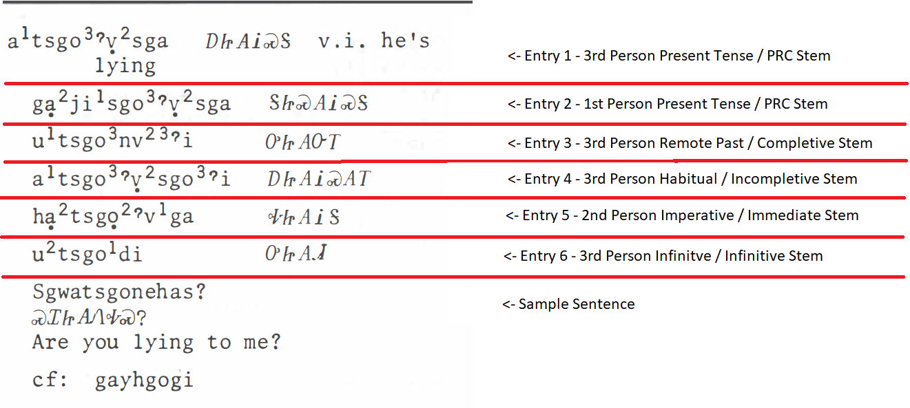
Cherokee English Dictionary Entries Explained
The following is a sample of an entry in the CED with explanations provided on the right

Slide 23
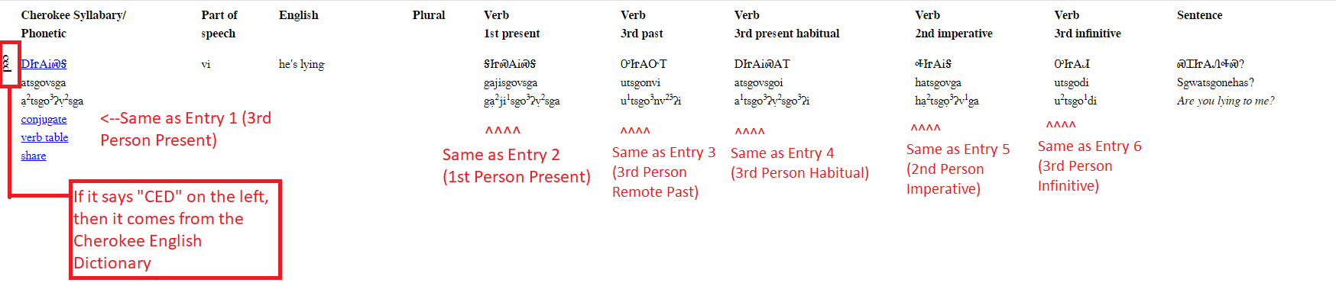
Cherokee English Dictionary Entries Explained
The following is a sample of an entry in the from Cherokeedictionary.net which has digitized the CED.

Slide 24
Putting It All Together
Following our understanding of the 5 Stems
And our understanding of how the CED is constructed
And how to build other conjugations from limited samples
Let’s look at the following entry from the CED
In this entry we will break down the Entry and Sub-Entry
Then we will separate the Pronominal, the Stem, and the Final Suffix
In this instance, we see a Vowel Fronted Stem

Slide 25
CED Page 61 - "He's Lying"
3rd | PRC | atsi,go'vsga | ᎠᏥ,Ꭺ'ᎥᏍᎦ
1st | PRC | gatsi,go'vsga | ᎦᏥ,Ꭺ'ᎥᏍᎦ | This plus 3rd Person Singular tell you if it is a “ga-” verb
3rd | RemPas (CMP) | utsi,gonv'i | ᎤᏥ,ᎪᏅ'Ꭲ | Needed for Completive Stem Elements
3rd | HAB (INC) | atsi,go'vsgo'i | ᎠᏥ,Ꭺ'ᎥᏍᎪ'Ꭲ | Needed for Incompletive Stem Elements {-g-}
2nd | IMM/COM | hatsi,go'vga | ᎭᏥ,Ꭺ'ᎥᎦ | Needed for the Immediate Stem. Will give {-esdi} (PFT) if no IMM command form exists.
3rd | INF | utsi,godi | ᎤᏥ,ᎪᏗ | Needed for INF Stem Elements.

Slide 26
CED Page 61 - "He's Lying"
3rd | PRC | atsi,go'vsga | ᎠᏥ,Ꭺ'ᎥᏍᎦ | - | atsi,go'vsga | -(a)
1st | PRC | gatsi,go'vsga | ᎦᏥ,ᏍᎪ'ᎥᏍᎦ | g- | atsi,go'vsga | -(a)
3rd | RemPas (CMP) | utsi,gonv'i | ᎤᏥ,ᎪᏅ'Ꭲ | u- | atsi,gon | -v'i
3rd | HAB (INC) | atsi,go'vsgo'i | ᎠᏥ,Ꭺ'ᎥᏍᎪ'Ꭲ | - | atsi,go'vsg | -o’i
2nd | IMM/COM | hatsi,go'vga | ᎭᏥ,Ꭺ'ᎥᎦ | h- | atsi,go’vga | -(a)
3rd | INF | utsi,godi | ᎤᏥ,ᎪᏗ | u- | atsi,go | -di
This is a vowel fronted Stem with vowel /-a/ as the first sound in all Stem variations.
The 3rd Person Set A forms either are just using the vowel from the Stem.
The Suffix of PRC and IMM/COM can stay for all conjugation changes in that set.

Slide 27
Let’s See We Can Build
Now that we have our Entry from the CED
And we separated the Stems and Affixes
Let’s place them on a conjugation chart
In the following slide you will see a version with just the offerings from the CED
But in the second slide, using only the rules and conventions shown in this Unit, we were able to build out the rest of the conjugation chart.
As always, we have only made predictions. We would need a Speaker to verify these entries.

Slide 30
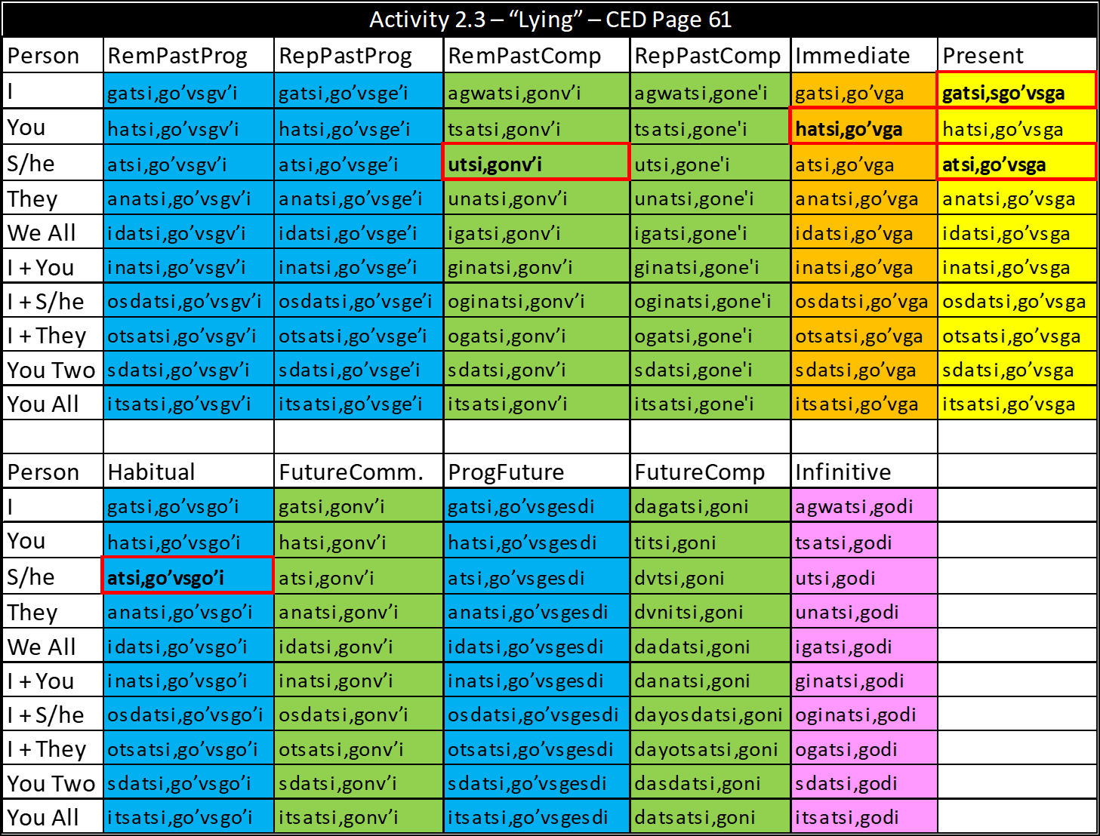

Slide 32
So, now what?
Now that we know how to use the CED more effectively, we can make better use of it’s content to find the forms we need for a specific expression.
This also allows us to reduce the forms we request from a Speaker, so we only really need to ask the follow questions:
    How do I say “I am doing _____ right now” = PRC Stem
    How do I say “He or She is doing _____ right now” = PRC Stem
    How do I say “He or She did _____ in the past” = Completive Stem
    How do I say “He or She does _____ regularly” = Incompletive Stem
    How do I say “You do _____ now” = Immediate Stem
    How do I say “He or she wants to do _____” = Infinitive Stem
But wait! There are a bunch of other verb forms that I keep hearing about right!?

Slide 33
More Pronominals! – Combined Local Pronominals
Cherokee Language considers those involved in the conversation (the speaker and the person(s) they are speaking to) to be “Local”
All 3rd Persons are considered Non-Local
All Local Subjects of a verb will be indicated in the Pronominal
This means that if we have multiple subjects that are local, we need an additional set of Pronouns.
These are called Combined Local Pronominals
We also need a new set of Pronominals if the Subjects is 3rd Person non-singular performing the action to a Local object.

Slide 34
Non-Singular Subject to Local Objects
The standard stative verb will use a Set B pronoun.
ᎠᎩᏲᏏ = I am hungry
Another way to think of this is “hunger his happening to me”
If the subject is non-Singular 3rd Person, and relevant to the conversation, you may use a different set of pronouns shown in the next slide.
These pronouns are best used when the subjects are known, and the action is specific enough to benefit from clarification

Slide 35
Non-Singular Subject to Local Objects
Subject(s)-Object(s) | Pronominal
They to Me | gvgi-
 | gvgw-
They to you and me | gegini-
They to all of us | gegi-
They to s/he and I | gogini-
They to us (not you) | gogi-
They to you | getsa-
They to you two | gesdi-
They to you all | getsi-

Slide 36
Combined Local Subjects
When the Subjects are all Local, we have an additional set of pronouns.
This occurs when some combination of the speaker/listener is non-Singular.
Since Local subjects can also be Dual, then we have additional options
Looking at the next slide, you will see these pronouns explained more clearly.
Take note of how some of these pronouns are identical to each other
When this occurs, you will need additional information to clarify the subject, but the verb will still conjugate the same

Slide 37
Combined Local Subjects
Subject/Object | Prefix
You to Me | sgi- / [sgw-]
You to Us 2 | sgini- / [sgin-]
You 2 to Me | sgini- / [sgin-]
You 2 to Us 2 | sgini- / [sgin-]
You to Us | isgi- / [isgiy-]
You 2 to Us | isgi- / [isgiy-]
You All to Me | isgi- / [isgiy-]
You All to Us 2 | isgi- / [isgiy-]
Me to You | gv- / [gvy-]
Me to You 2 | sdv- / [sdvy-]
Us 2 to You | sdv- / [sdvy-]
Us 2 to You 2 | sdv- / [sdvy-]
Me to You all | itsv- / [itsvy-]
Us to You | itsv- / [itsvy-]

Slide 38
Object Focused Pronominal Prefixes
When the subject is unstated or unimportant, there is an additional set of pronouns can be used.
These pronouns are best used when the action that is taking place is the only relevant piece of data
This may also be used if the Subject is unknown, but the results of the action are clear
See the following table for a list of these pronouns

Slide 39
Object Focused Pronominal Prefixes
Subject/Object | Prefix
N/A to Me | vgi- [vgw-]
N/A to You | etsa-
N/A to Him/Her | atsi- [ag-]
N/A to You and I | egini-
N/A to Us 2 | ogini-
N/A to All of Us | egi-
N/A to Us | ogi-
N/A to You 2 | esdi-
N/A to You All | etsi-
N/A to Them | getsi- [geg-]

Slide 40
Put Them All Together
These new Pronominals function by the same rules as the standard Set A or Set B verbs.
They still follow vowel clash rules
  Some have specific alterations when presented with a vowel clash, which are indicated with [ ] enclosures
They can still be attached to other affixes and pre-pronominals
They also follow many of the same conventions for conjugating tenses assuming you follow the 5-Stem system

Slide 41
Reflexive Prefixes
The final component for verb construction for this unit is the Reflexive Prefix.
This is used when the Subject and the Object of the action are the same
This prefix /-adad-/ appears after the pronominal, but before the verb stem
  If it appears before vowels other than /a/, use /-adad-/
  If it appears before the vowel /a/, use /-ad-/
  If it appears before a consonant, use /-ada-/

Slide 42
What else?
There are several other factors that can impact the development of a verb in Cherokee.
Affixes like the non-final suffixes and other pre-pronominal prefixes may also have an impact on the verb
What is important for this unit is that you master the 3 core elements of the verb and the main variations of those elements.
Going forwards, you should understand what a Pronominal is and how to find it.
You should understand what a Stem is, and how to find it with the right examples
You should understand what a Final Suffix is, and how to use them to indicate tense

